Slide 1
Group Role Assignment with Cooperation
and Conflict Factors
Lab 4 | Qian Jiang
MUST | F.I.E

Slide 2
Content
Preliminary Knowledge
Objectives
Assignment
Turn in Requirement
Notes:
This lab lesson is divided into four parts. First, we will introduce some preliminary knowledge about Group Role Assignment with cooperation and conflict factors and the relevant programming information to solve this model. Next, we will talk about the objectives for this lesson. Then, we will talk about the assignment for this lesson and its requirement. (Next slide)

Slide 3
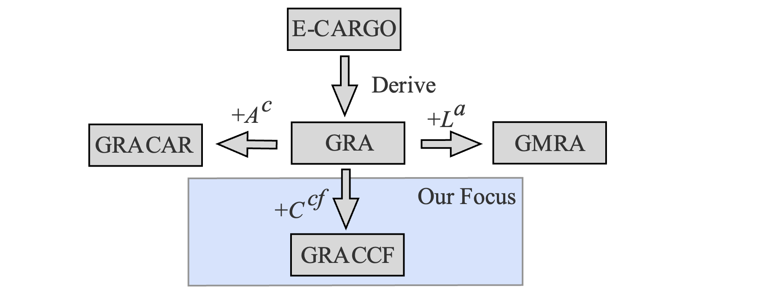
Preliminary Knowledge-Preview
Group Role Assignment with Cooperation and Conflict Factors (GRACCF) is derived from the Group Role Assignment (GRA) submodel.
Unlike the GRACAR model, which only considers conflicts between agents when performing the same role, the GRACCF model is applicable when there are differences between roles, and it refines the granularity of conflict and collaboration relationships.
The GRACCF model introduces the cooperation and conflict factors matrix C^{cf} to formalize the cooperation and conflicted relationship between agents when playing roles.
Development of the GRACCF model
The GRACCF model is also derived from the GRA model.
Notes:
Group Role Assignment with Cooperation and Conflict Factors (GRACCF) is derived from the Group Role Assignment (GRA) and Group Role Assignment, the GRACCF model also extends the applicable scenarios compared with the GRA model. Unlike the GRACAR model, which only considers conflicts between agents when performing the same role, the GRACCF model is applicable when there are differences between roles, and it refines the granularity of conflict and collaboration relationships. The GRACCF model introduces the cooperation and conflict factors matrix C^{cf} to formalize the cooperation and conflicted relationship between agents when playing roles. The conflict degree between them can be represented from -1 to 0, and the degree of their cooperation can be represented from 0 to 1.

Slide 4
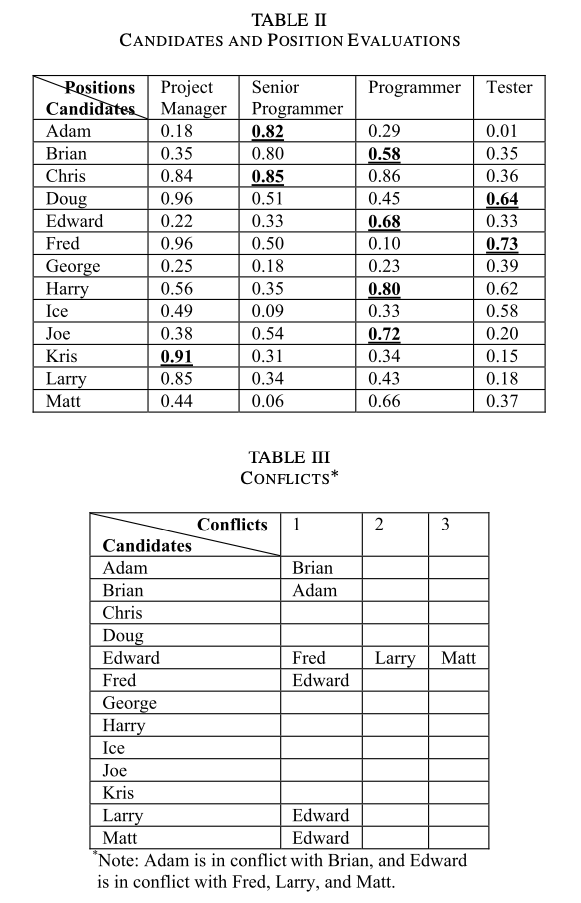
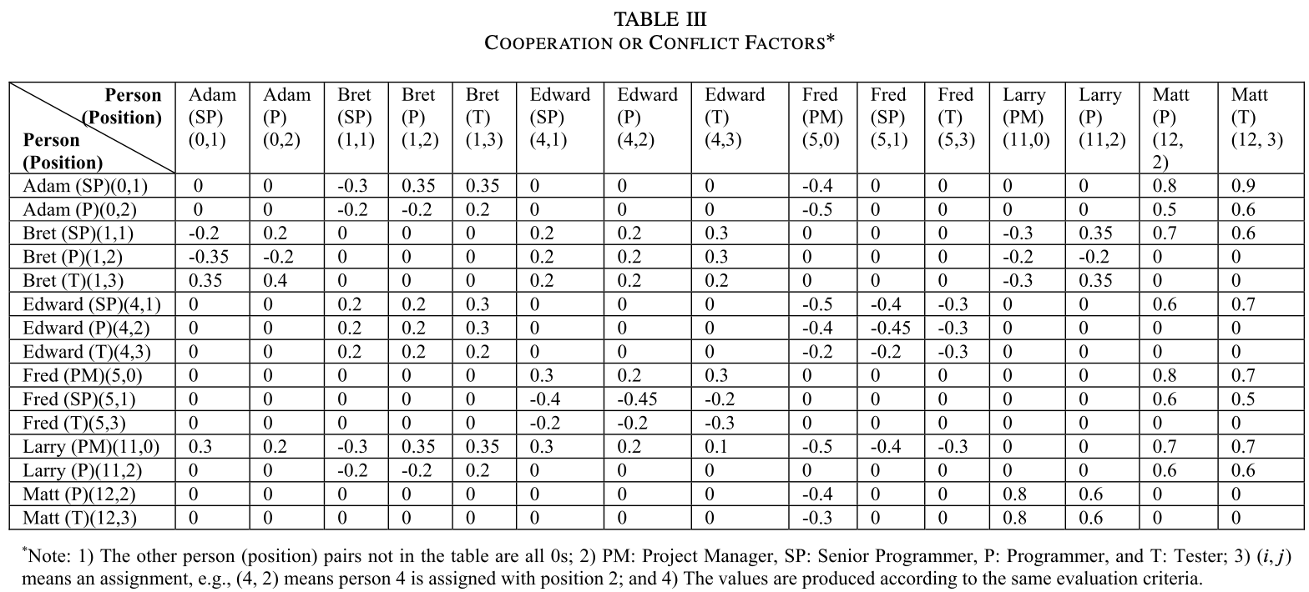
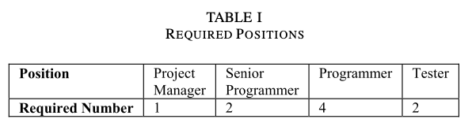
Preliminary Knowledge-A Real-world Scenario
Decision-makers of company X decides to organize a team from employees with the budget of one million dollars.
From historical experience, some employees have cooperation intentions and conflicts for different reasons, such as personalities, working styles, emotional issues, and political beliefs (see Table III).
Goal: Help decision-makers build the most suitable team after considering cooperative and conflicted factors among employees.
Notes:
In company X, Ann, the Chief Executive Officer, has just signed a contract the value of which is a million dollars. She asks Bob, the Human Resources officer, to organize a team from the employees of the company. Bob drafts a position list shown in Table I for the team and a candidate staff shortlist shown in Table II, where the numbers in parentheses are indices of positions and people. Then, Bob initiates an evaluation process and asks the branch officers to evaluate the employees for each possible position (Table II). After that, when Ann and Bob have a meeting with the branch officers to assign the positions to the candidate employees, the officers report that from historical experience, some employees have cooperation intentions and conflicts for different reasons, such as personalities, working styles, emotional issues, and political beliefs. Ann asks the branch officers to evaluate the degrees of all the significant CC effects and the evaluation results are shown in Table III.
In Table III, the 0s means no effect exists; the numbers less than 0 means that there is conflict, but those larger than 0 indicate cooperation. For example, the number means the changing degree of employees’ qualification values, i.e., the cross point of “Edward (SP)(4, 1)” and “Bret (T)(1, 3)” is 0.3 meaning that the qualification value of Edward as a Senior Programmer (SP) increases by 30% if Bret takes the position of a Tester (T). That is to say, employees in good relationships will increase their performance if they are doing related jobs and those in conflict may decrease their performance.

Slide 5
Preliminary Knowledge-GRACCF Model
∑ ::= <C, O, A, M, R, E, G, s₀, H>
Environments
Classes
Agents
Roles
Groups
Objects
Object-based
Agent-based
Role-based
Development of the GRACCF model
Roles (Tasks): Required Positions Agents (Executors): Employees
Notes:
Based on the real-world scenario of the GRACAR model, it is easy to deduce that the roles are the positions required by the new team, and the agents are the employees.

Slide 6
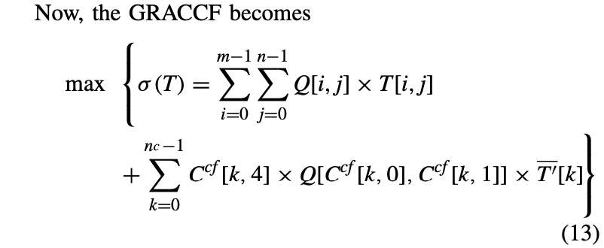
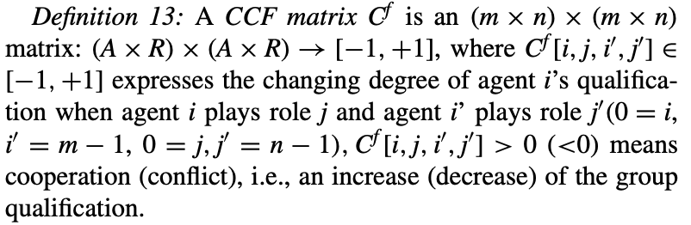
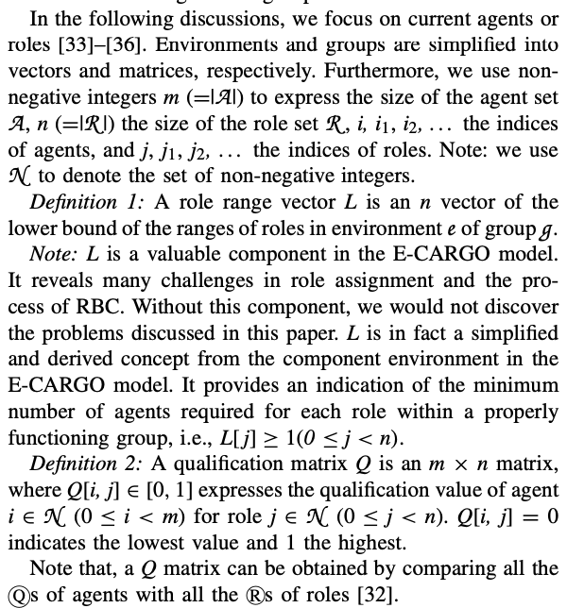
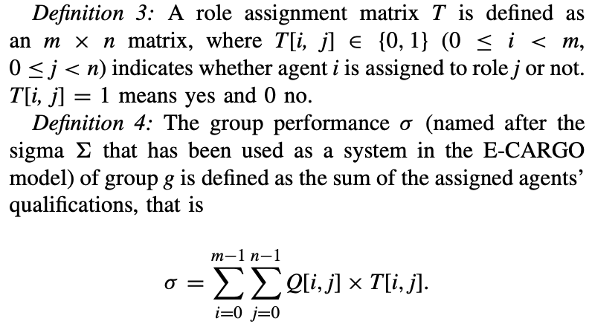
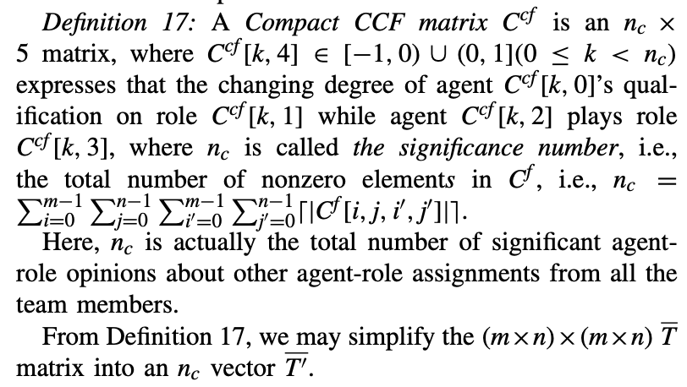
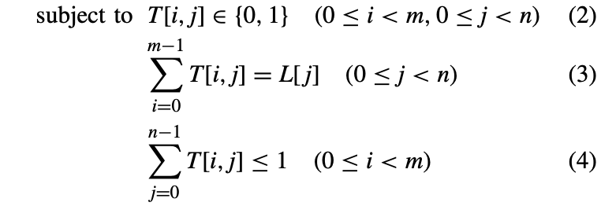
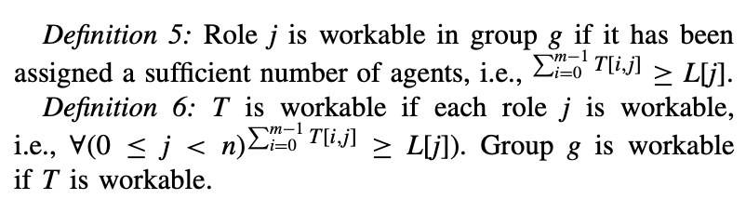
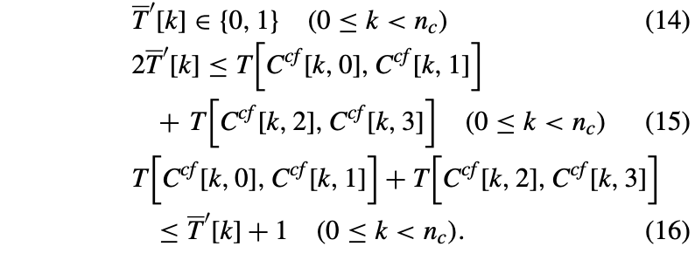
Preliminary Knowledge-GRACCF Model
∑ ::= <C, O, A, M, R, E, G, s₀, H>
Environments
Classes
Agents
Roles
Groups
Objects
Object-based
Agent-based
Role-based
Notes:
Same as the GRA model, we also mathematically formalize the GMRA model. Definitions 1-6 is the same as the GRA model and GMRA model. The biggest difference between GRACAR model and the GRA model is introducing the new Definitions 13 and 17. The CCF matrix in Definition 13 is the cooperation and conflict factors matrix, which is utilized to express the cooperative and conflicted relationships among agents when playing roles. the compact CCF matrix is a compact version of the CCF matrix in Definition 13 and it achieves dimensional reduction. Each element in compact CCF matrix is a 5-dimension vector. The first two dimensions of this vector represent the index of the first agent and its corresponding role index, while the latter two dimensions signify the index of the second agent and its corresponding role index. The last dimension represents the degree of cooperation or conflict.
Based on above analysis, the mathematical expression of the GRACCF model is illustrated above.

Slide 7
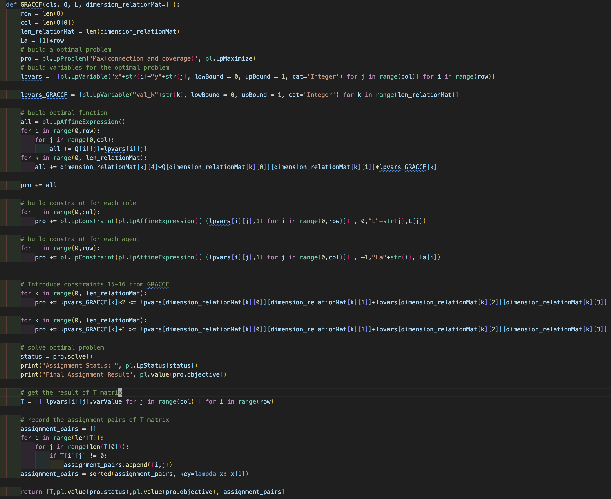
Preliminary Knowledge-Python Code Presentation

Slide 8
Content
Preliminary Knowledge
Objectives
Assignment
Turn in Requirement
Notes:
This lab lesson is divided into five parts. First, we will introduce some preliminary knowledge about Group Role Assignment or the relevant programming information to solve this model. Next, we will talk about the objectives for this lesson. Then, we will talk about the assignment for this lesson and its requirement. (Next slide)

Slide 9
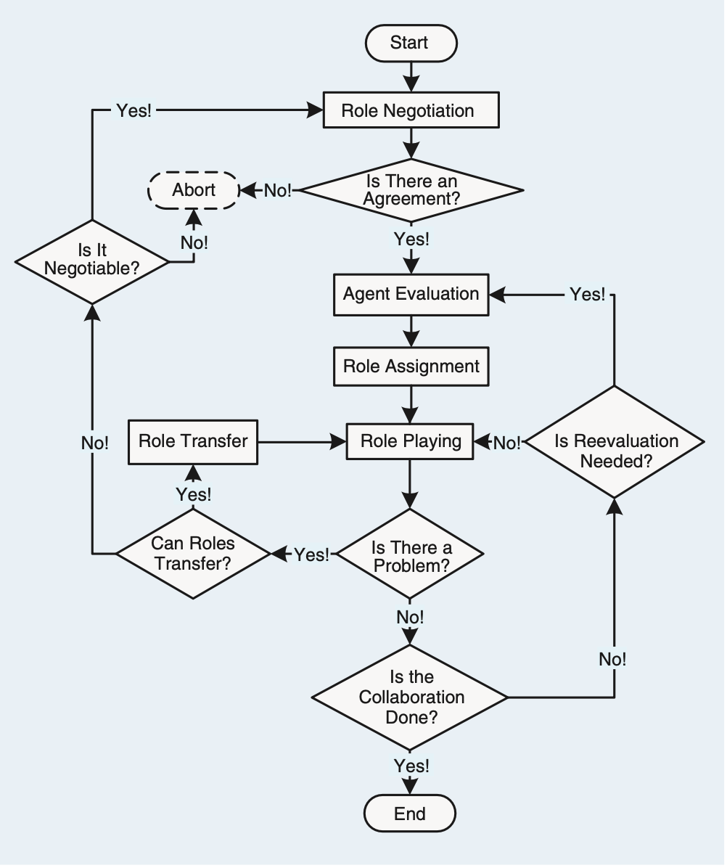
Objectives
The objectives of this course are two-fold:
1. To understand the process of RBC and learn about how to formalize problems with the GRACCF submodel;
2. To practice using Python to program the GRACCF model.
Notes:
The objectives of this course are two-fold:
1. To understand the process of RBC and learn about how to formalize problems with the GRACCF submodel;
2. To practice using Python to program the GRACCF model.

Slide 10
Content
Preliminary Knowledge
Objectives
Assignment
Turn in Requirement
Notes:
This lab lesson is divided into five parts. First, we will introduce some preliminary knowledge about Group Role Assignment or the relevant programming information to solve this model. Next, we will talk about the objectives for this lesson. Then, we will talk about the assignment for this lesson and its requirement. (Next slide)

Slide 11
Assignment
The assignment requirements for this lesson are as follows:
1. Suppose you are a manager of a company. Imagine and describe a scenario, i.e., to accomplish a complex task (RBC) by managing 6-8 agents (people, equipment, robots, groups of people, etc.). In addition to the scenario required for the first lesson assignment, Add a constraint that when different agents perform different roles, they may have cooperation and conflict relationships. Use the C^{cf} matrix to represent this cooperation and conflict relationship. The degree of cooperation is represented by a floating-point number from 0 to 1, with larger values indicating more pleasant cooperation. The conflicting relationship is represented by a floating-point value from -1 to 0, with smaller values indicating less conflict.
2. You need to divide the complex into smaller subtasks (Roles). Be creative, and any simple method can be used.
3. You can choose from a list of candidates (Agents) to join the team to accomplish the task. Be creative, and any simple method can be used.

Slide 12
Assignment
4. You need to determine a list of requirements for each task (role), i.e., role specification including L and other required properties. Be creative and reasonable. Any simple method can be used.
5. Suppose that every agent should have a list of qualifications corresponding to the roles’ requirements. You create the evaluation of each agent for each subtask (role), i.e., the Q matrix. Be creative, and any simple method can be used.
6. After you obtain the Q matrix, use the GRACCF program to get the optimal assignment result, i.e., T.
7. Analyze whether the assignment is good or not from your own personal perspective. Argue why an optimized assignment result may not be the best choice.

Slide 13
Assignment
8. Consider whether there are scalable aspects in this scenario (i.e., future works), as this is relevant to future lessons.
9. Encode and calculate assignment results using Python’s PuLP, and present the mathematical model and corresponding assignment results in the format of an IEEE paper.
10. If possible, please choose to expand the self-defined scenario from the first lesson, to make the background of the problem you are researching more generic.
*11. This is an optional question. Read Ref [1], and based on your own understanding, explain the evolution process of the GRACCF model in Ref [1], that is, how does the GRACCF model transform from a nonlinear model to a linear model?
[1] H. Zhu, Y. Sheng, X. Zhou, and Y. Zhu, “Group Role Assignment With Cooperation and Conflict Factors,” IEEE Trans. Syst. Man, Cybern. Syst., vol. 48, no. 6, pp. 851–863, 2018.

Slide 14
Content
Preliminary Knowledge
Objectives
Assignment
Turn in Requirement
Notes:
This lab lesson is divided into five parts. First, we will introduce some preliminary knowledge about Group Role Assignment or the relevant programming information to solve this model. Next, we will talk about the objectives for this lesson. Then, we will talk about the assignment for this lesson and its requirement. (Next slide)

Slide 15
Turn in Requirement
1. A project report including the descriptions of your process details.
2. The report should be in the IEEE conference paper format, page limit = 4 pages. Refer to: https://www.ieee.org/conferences/publishing/templates.html, Choose Microsoft Word and US letter.
3. (*Vital) The submitted paper should provide the source code and simulation data. The paper should also depict plausible scenarios and provide a rational explanation for the data.
Download the Relevant Materials:
https://github.com/jiangqian1997/E-CARGO-Codes/tree/main/Summber_School_Laboratory/Lab_4

